Slide 1
The space of human body shapes: reconstruction and parameterization from range scans
Brett Allen, Brian Curless, and Zoran Popovic
2018. 5. 3
Presenter: Sesong Kim

Slide 2
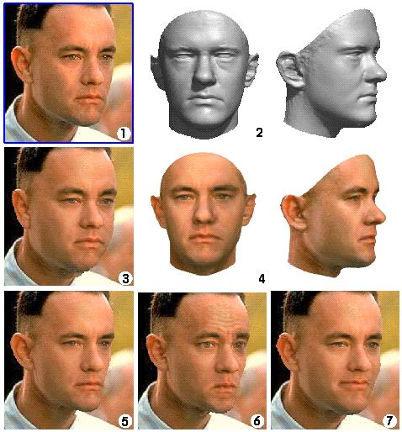
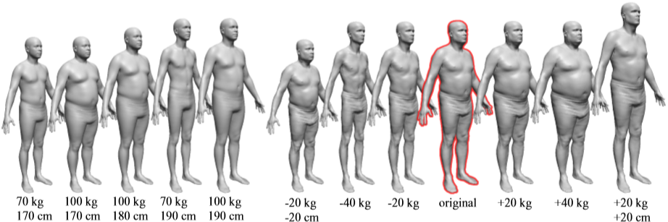
1. Introduction
It propose a method for creating a whole-body morphable model based on 3D scanned examples in the spirit of Blanz and Vetter’s morphable face model [1999].

Slide 3
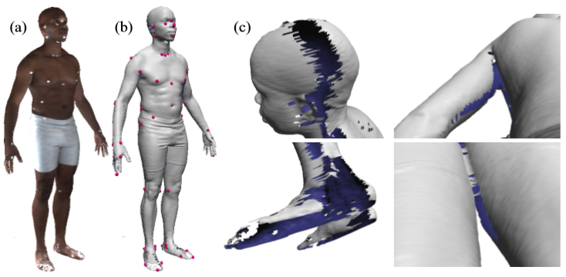
Dataset
Civilian American and European Surface Anthropometry Resource Project (CAESAR)
Thousands of range scans of volunteers aged 18–65 in the United States and Europe
74 white markers
The reconstructed meshes are not complete, due to occlusions and grazing angle views.
This paper use a subset of the meshes in the CAESAR dataset, consisting of 125 male and 125 female scans with a wide variety of body types and ethnicities.

Slide 4
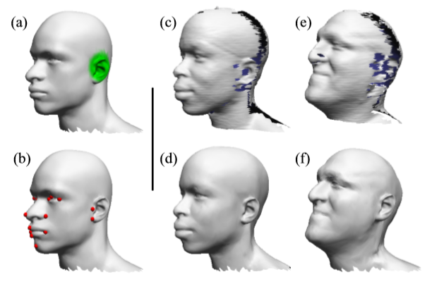
1. Introduction
(a): The template mesh(artist generated)
(b): Since the template mesh doesn’t have the markers, use a different set of markers based on visually-identiﬁable features to ensure good correspondence.
(c), (e): Heads of the subjects. Interior surfaces are tinted blue.
(d), (f): The templates mapped to (c), (e).
The holes have been ﬁlled in, and the template ear has been plausibly rotated and scaled.

Slide 5
2. Related work
Praun et al. [2001]
  Establish an n-way correspondence between arbitrary meshes of the same topological type with feature markers.
  Unfortunately, whole body range scans contain numerous holes.
Davis et al. [2002], Carr et al. [2001]; Whitaker [1998]
  Direct hole-free reconstruction methods have the nice feature that holes are filled in a smooth manner.
  However, while smooth hole-filling is reasonable in some areas, such as the top of the head and possibly in the underarm, other areas should not be filled smoothly.

Slide 6
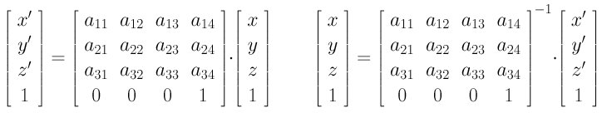
3. Algorithm
The objective function is a weighted combination of three measures:
Data error: proximity of transformed vertices to the range data
Smoothness error: similarity between neighboring transformations
Marker error: proximity of sparse markers at corresponding locations on the template and target surface.
Find affine transform matrix which minimize sum of error.

Slide 7
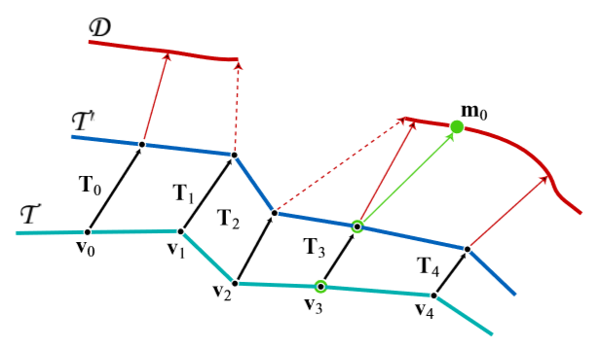
3 Error
T_i: set of afﬁne transformations which makes T into T’
v_i: the vertices vi of the template surface T
v_3: marker of template mesh
m_0: marker of scanned data
The data error, indicated by the red arrows, is a weighted sum of the squared distances between the transformed template surface and D.
The smoothness error penalizes differences between adjacent transform matrices.
The marker error penalizes distance between the marker points on the transformed surface and on D.

Slide 8
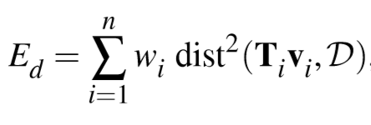
3.1 Data error
The template surface should be as close as possible to the target surface
dist() function computes the distance to the closest point on D.

Slide 9
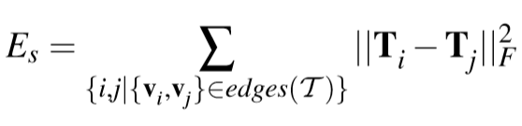

3.2 Smoothness error
Not smoothness of the deformed surface itself,
but smoothness of the actual deformation applied to the template surface.
||·||F is the Frobenius norm

Slide 10
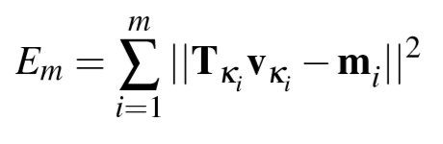
3.3 Marker error
In the more common situation, where T and D are not close, the optimization can become stuck in local minima.
To avoid this problem, the marker error term minimizes the distance between each marker’s location on the template surface and its location on the scanned surface.

Slide 11
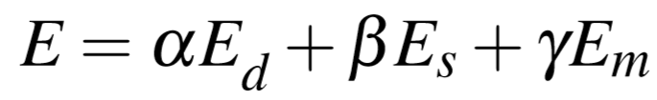
3.4 Combining the error
We run the optimization using L-BFGS-B, a quasi-Newtonian solver
Smoothness error is very localized; changes to the afﬁne transformation need to diffuse through the mesh neighbor-by-neighbor with each iteration of the solver.
This locality leads to slow convergence and makes it easy to get fall into local minima.
Avoid this problem by taking a multiresolution approach.
Using the adaptive parameterization framework of Lee et al. [1998], we generate a high and a low resolution version of our template mesh, and the relationship between the vertices of each.
Smoothness error

Slide 12
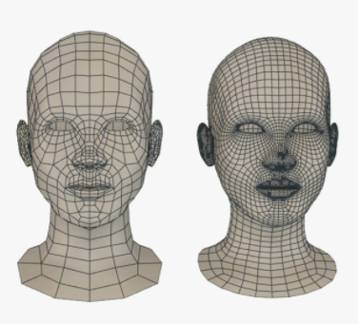
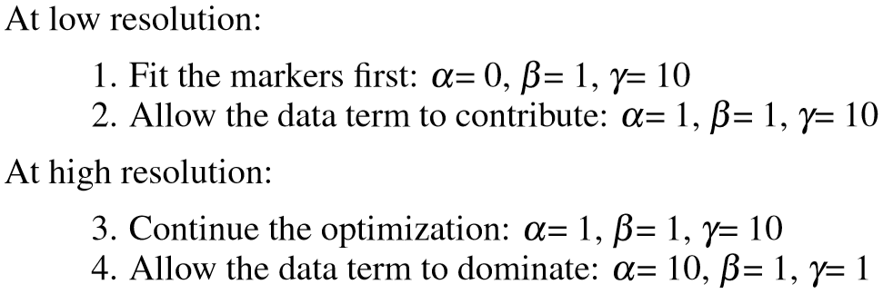
3.4 Combining the error
First, run the optimization using the low resolution version of T and a smoothed version of D.
Second, the transformation matrices are up-sampled to the high-resolution version of T ,and complete the optimization at full resolution.
Although the marker data is useful for global optimization, the placement of the markers was somewhat unreliable.
To reduce the effect of variable marker placement, reduce the weight of the marker term in the ﬁnal stages of the optimization.

Slide 13
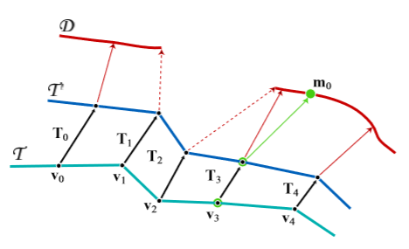
3.5 Hole-filling
Suppose that the closest point on D to a transformed template point is located on a boundary edge of D (as shown by the dashed red lines in Figure).
In this situation we set the weight w_i in data error to zero, so that the transformations matrix only be affected by the smoothness error.
Set w_i to zero where there is no data
Down-weight the importance of poor data

Slide 14
3.5 Hole-filling
In some areas, such as the ears and the ﬁngers, the scanned data is particularly poor
Matching these fragments to the detailed template surface is quite difﬁcult.
Manually identifying areas on the template scanned poorly, prefer the template surface to the scanned surface when ﬁtting these areas.
In the marked areas, we modify the data error’s w_i using a multiplicative factor of zero,
tapering towards 1 at the boundary of the marked area.

Slide 15
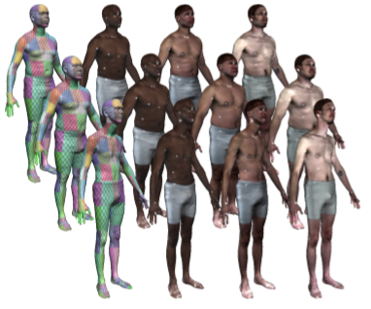
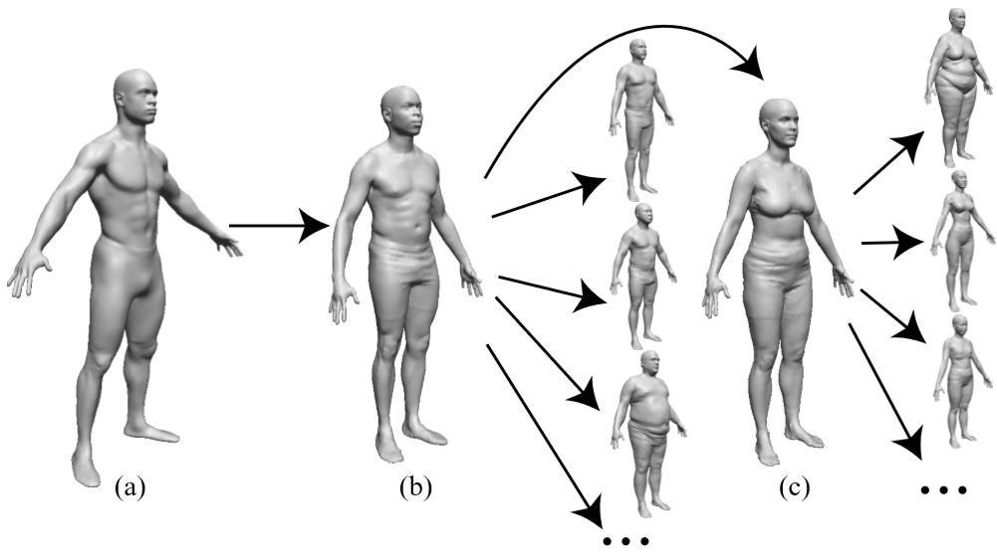
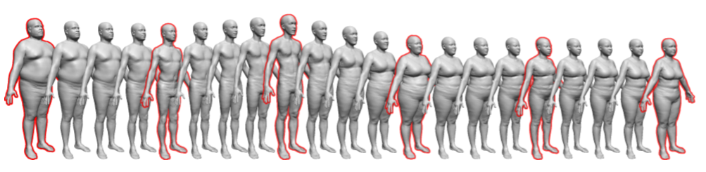
4 Application

